Slide 1
Department of Electronics and Communication Engineering
M.I.E.T. ENGINEERING COLLEGE
AIR AMBULANCE
Presented by : Karthick Pandiyan R
Ayyanar.S
Abdul Aziz M
Jegan.J
Guide : Dr. Ayshathul Fouzia Abdul Gani
27-03-2023
EPTC 2019

Slide 2
Outline of Presentation
Objective of the project
Introduction to proposed methodology
Existing methodologies in literature
Proposed methodology
Introduction to simulation tools used
Work done /Results
References
2/13
EPTC 2019

Slide 3
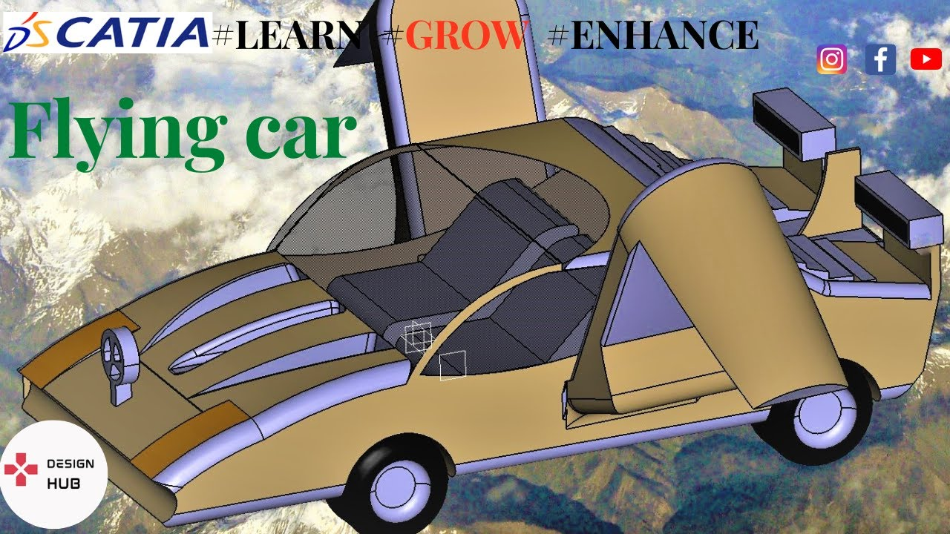
Motivation
Motivation
Although various methods are employed to decongest our country's road traffic, they are ineffective in the long run.
Many casualties are increasing due to this traffic jam.
Application
Thus time does not increase.
Control the accident.
Tools used
Ardiuno
Drone
Thermacol Sheet
Air Bags
Aluminium Sheet
Helium Gas
Wheels
Flight Control
Fig. 1– Biomedical applications
3/13
EPTC 2019

Slide 4
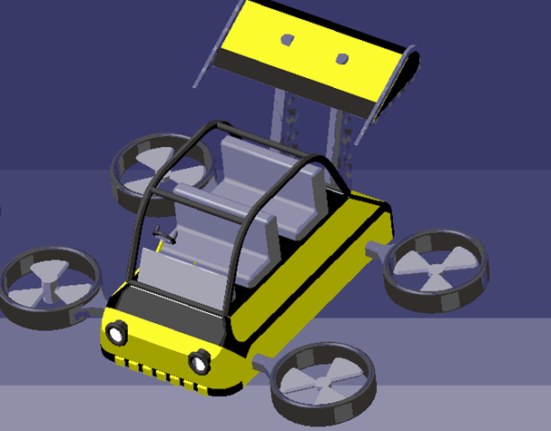
Introduction to proposed methodology
This machine is designed to save people's lives quickly
Health care
Technology scaling – high levels of integration in vehicle design.
A common process in mechanics is that single and multiple drones are accompanied by a helium gas that helps them move in three directions on water, land, and air.
Mainly used for Drone and helium gas
The main objective of the project is to create accurate and reliable output through IOT technology and embedded system and save lives using a mobile vehicle with all the good and auxiliary features to save lives.
4/13
EPTC 2019

Slide 5
Existing methodologies in literature
Altran has proposed an EN-ROUTE TO URBAN AIR MOBILITY
The search is on for better, more sustainable transportation technologies and models to improve commute times and accelerate the transport of goods across town [15].
FLYING VEHICLE:
The flying vehicle of claim is proposed by Bogdan Radu, further comprising an emergency parachute which may be deployed for emergency landing[6]
5/13
EPTC 2019

Slide 6
Existing methodologies in literature
TABLE 2 : Performance comparison of proposed AiP
Ref | Title | Parametr1 | Parameter2
[7]Altran En-Route to Urban Air Mobility on the Fast Track to Viable and Safe on-Demand Air Services.(Mar.2020) | EN-ROUTE TO URBAN AIR MOBILITY | Roadways: 30 km/hr Airways: 225 km/hr | Budget: MarketsandMarkets: $15 billion Morgan Stanley: $322 billion
[1]Encyclopaedia Britannica, Inc(Dec 22) | Helium- Britannica Online Encyclopedia | melting point: none Boiling point: -268.9° C | Density (1 atm, 0 °C) :0.1785 gram/litre. Atomic Weight: 4.002602
6/13
EPTC 2019

Slide 7
Proposed Methodology
As new and advanced ideas are applied in biomedical applications, this project can be well used in biomedical field.
Due to the old age of the people in our country we are prone to many diseases and it is based on our great help to our people.
Due to the increasing number of vehicles on the road and poor road maintenance, timely access to hospital is a major challenge in our country.
By using loT technology as a solution to such situations, we can reach the hospital quickly and help the patient, and our country can progress beyond the current development, both mentally and physically.
A helium gas buoyancy balloon is added to the bottom of this vehicle, so this vehicle is able to float in water and can easily go to its destination even in water.
Promotes a good and satisfactory use of the domain and general public health care and society.
7/13
EPTC 2019

Slide 8
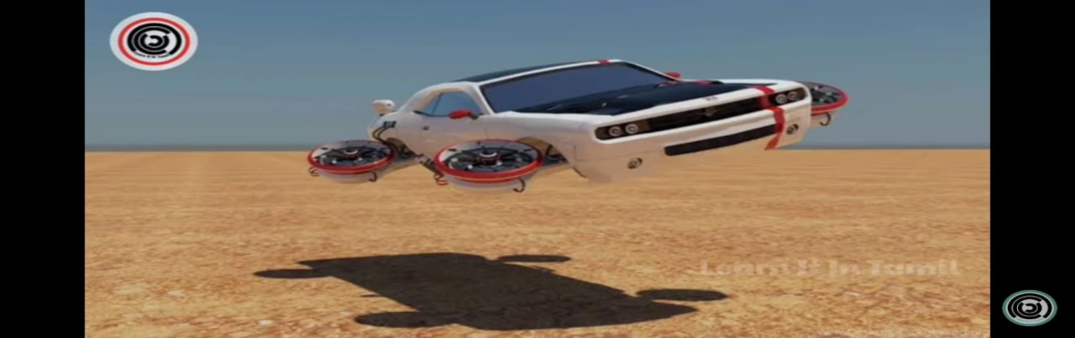
Introduction to simulation tools used
Tinkercad .–this is used for simulate and create a code for arduino sensors.
The major of project will be used for hardware.
8/13
EPTC 2019

Slide 9
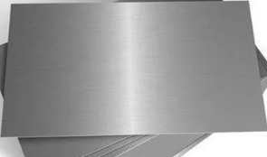
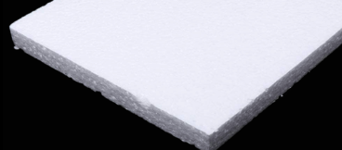
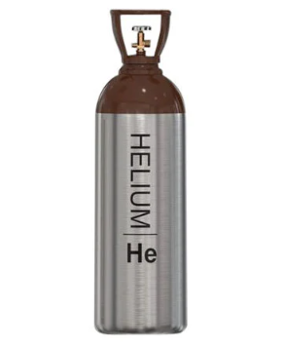
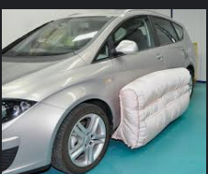
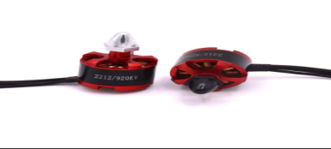
Work done
Aluminum Aluminum is the second most common metal in the world.
Thermacol As this vehicle rises, it is more likely to heat up due to solar heat. It also helps the vehicle to rise up.
Helium
Helium Helium gas is also used to float an object in air. By injecting this helium gas, objects of any size can be reduced from 100% to 30%.
Air Bags This is very helpful for lifting the vehicle. The inflated helium gas of this air bag is very helpful for flying and floating.
Drone A helium gas balloon attached to the bottom of the ambulance keeps the ambulance buoyant when submerged in water. The rear wheel mounted on the ambulance is raised by 30° and the ambulance is driven backwards. Ambulance has a 20 degree bank on the front wheel. Thus changing the position leads to the destination and reaches the destination
.
6/17
EPTC 2019

Slide 10
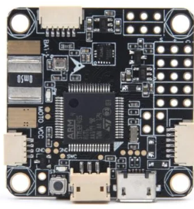
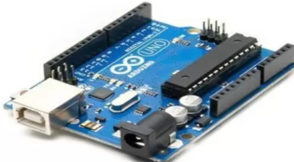
Work done
Flight Control
The flight controller is the brain of the drone, which controls the motors and ESCs in the drone. It is an electronics board in which sensors, processors, communication protocols, and transmitter pins are installed. A flight controller controls every aspect of the drone. It moves the drone by changing the motors' RPM.
Ardiuno Uno
Arduino UNO is a low-cost, flexible, and easy-to-use programmable open-source microcontroller board that can be integrated into a variety of electronic projects. This board can be interfaced with other Arduino boards, Arduino shields, Raspberry Pi boards and can control relays, LEDs, servos, and motors as an output.
10/13

Slide 11
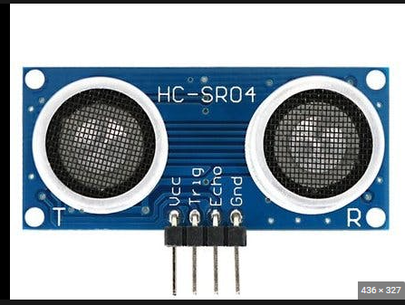
Work done
Ultrasonic sensors are used primarily as proximity sensors. They can be found in automobile self-parking technology and anti-collision safety systems. Ultrasonic sensors are also used in robotic obstacle detection systems, as well as manufacturing technology
Ultra sonic
11/13

Slide 12
Introduction Aperture coupled AiP
Class-E PA AoC AiP
Simulations Comparison References
References
Flying Car Transportation System: Advances, Techniques, and Challenges
Received December 28, 2020, accepted January 31, 2021, date of publication February 3, 2021, date of current version February 11, 2021.
Flying cars for green Transportation
Joule 3, 1180–1189, May 15, 2019 -2019 Published by Elsevier Inc.
Flying car Challenges and propulsion strategies.
Digital Object Identifier 10.1109/MELE.2015.2509901 Date of publication: 1 March 2016.
EN-ROUTE TO URBAN AIR MOBILITY .
Date of publication: 7 March 2022 and published by Altran.
12/13
EPTC 2019

Slide 13
THANK YOU
13/13
EPTC 2019

